Slide 2

Kamal Shree
Developer Advocate @Microsoft

Slide 3
Azure DevOps usage in Microsoft Teams

Slide 4
Agenda
DevOps
Statistics
Azure DevOps
Explore
Microsoft Teams
Integration
Community
Features

Slide 5
DevOps
“DevOps is the union of people, process and products to enable continuous delivery of value to your end users.”

Slide 6
Plan
code
Build
Test
Release
Deploy
Operate
Monitor
Continuous Delivery

Slide 7
Statistics
25% of software developers would like to acquire DevOps skills.
28% of recruiters have difficulties hiring the DevOps expertise they need.
38% of IT recruiters want to hire for DevOps skills
21% of software development teams adopted a DevOps approach to source code management in 2022

Slide 8
Why DevOps? What can Companies achieve with DevOps?

Slide 9
Reduce Failures
Accelerate Innovation
Increase Efficiency
Recovery Time
Improve Collaboration
Increased Revenue

Slide 10
Introducing Azure DevOps

Slide 11
Easy Collaboration
Build/Release
Plan Smarter, collaborate better and ship faster
Source Control Management
Agile/Scrum Boards

Slide 12





Azure Repos
Azure Pipelines
Azure Boards
Azure Test Plans
Azure Artifacts

Slide 13
Connectors
Webhooks and connectors help to connect the web services to channels and teams in Microsoft Teams. .

Slide 14
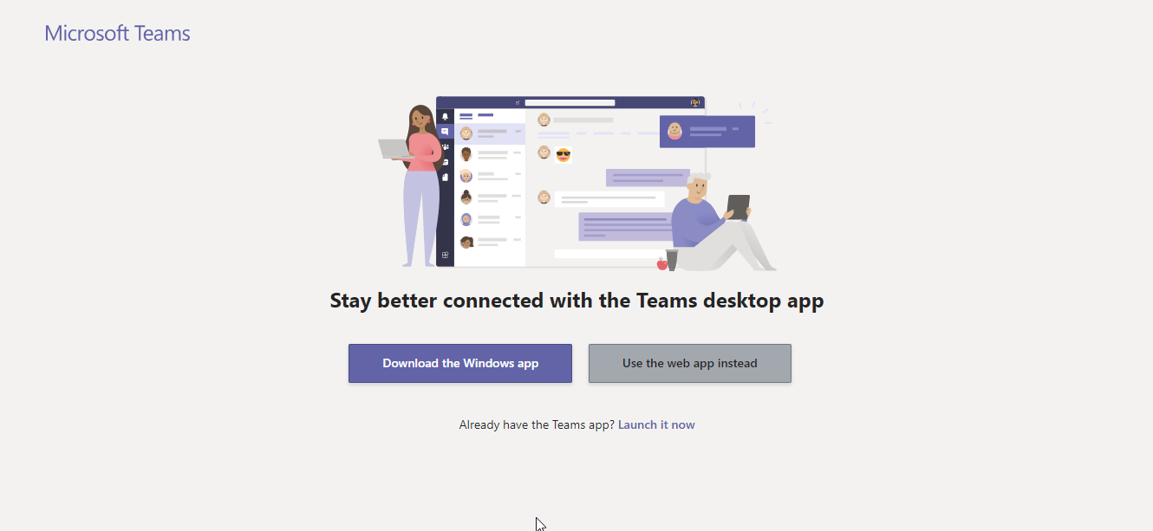
Microsoft Teams

Slide 15
Helper Bots
Real Time Document Collaborations
Customize your Workspace
Developer platform
Connectors

Slide 16
Microsoft Metaverse

Slide 17
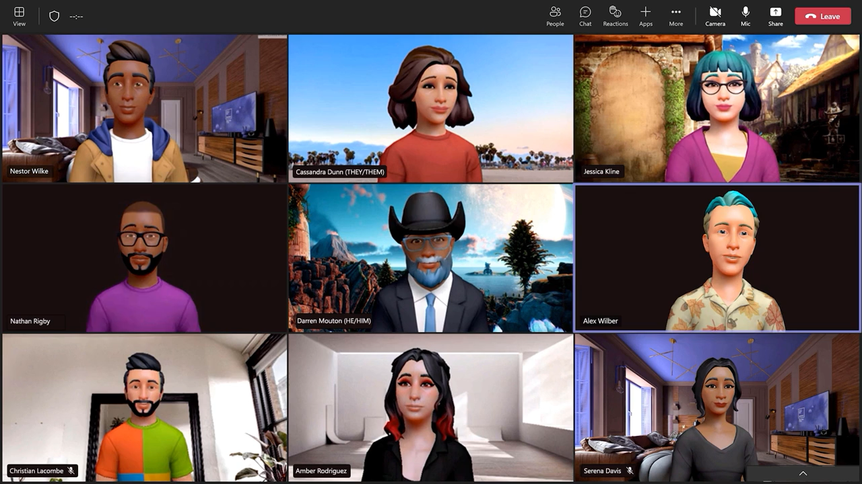

Slide 18
Azure DevOps Services (Collaborate, Communicate and Celebrate)

Slide 19
Prerequisite
Office365 account
Azure DevOps Setup

Slide 20

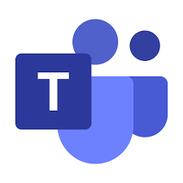


Slide 21
Create Teams
Connector
Azure Devops
Add a Kanban board
Add Tab
Connect Organization
Azure Pipelines
Add the Team
Set up a bot

Slide 22
What’s new in Azure DevOps

Slide 23
Azure Boards app for Microsoft Teams
Import work items from a CSV file
Quick navigation in Azure Boards search

Slide 24
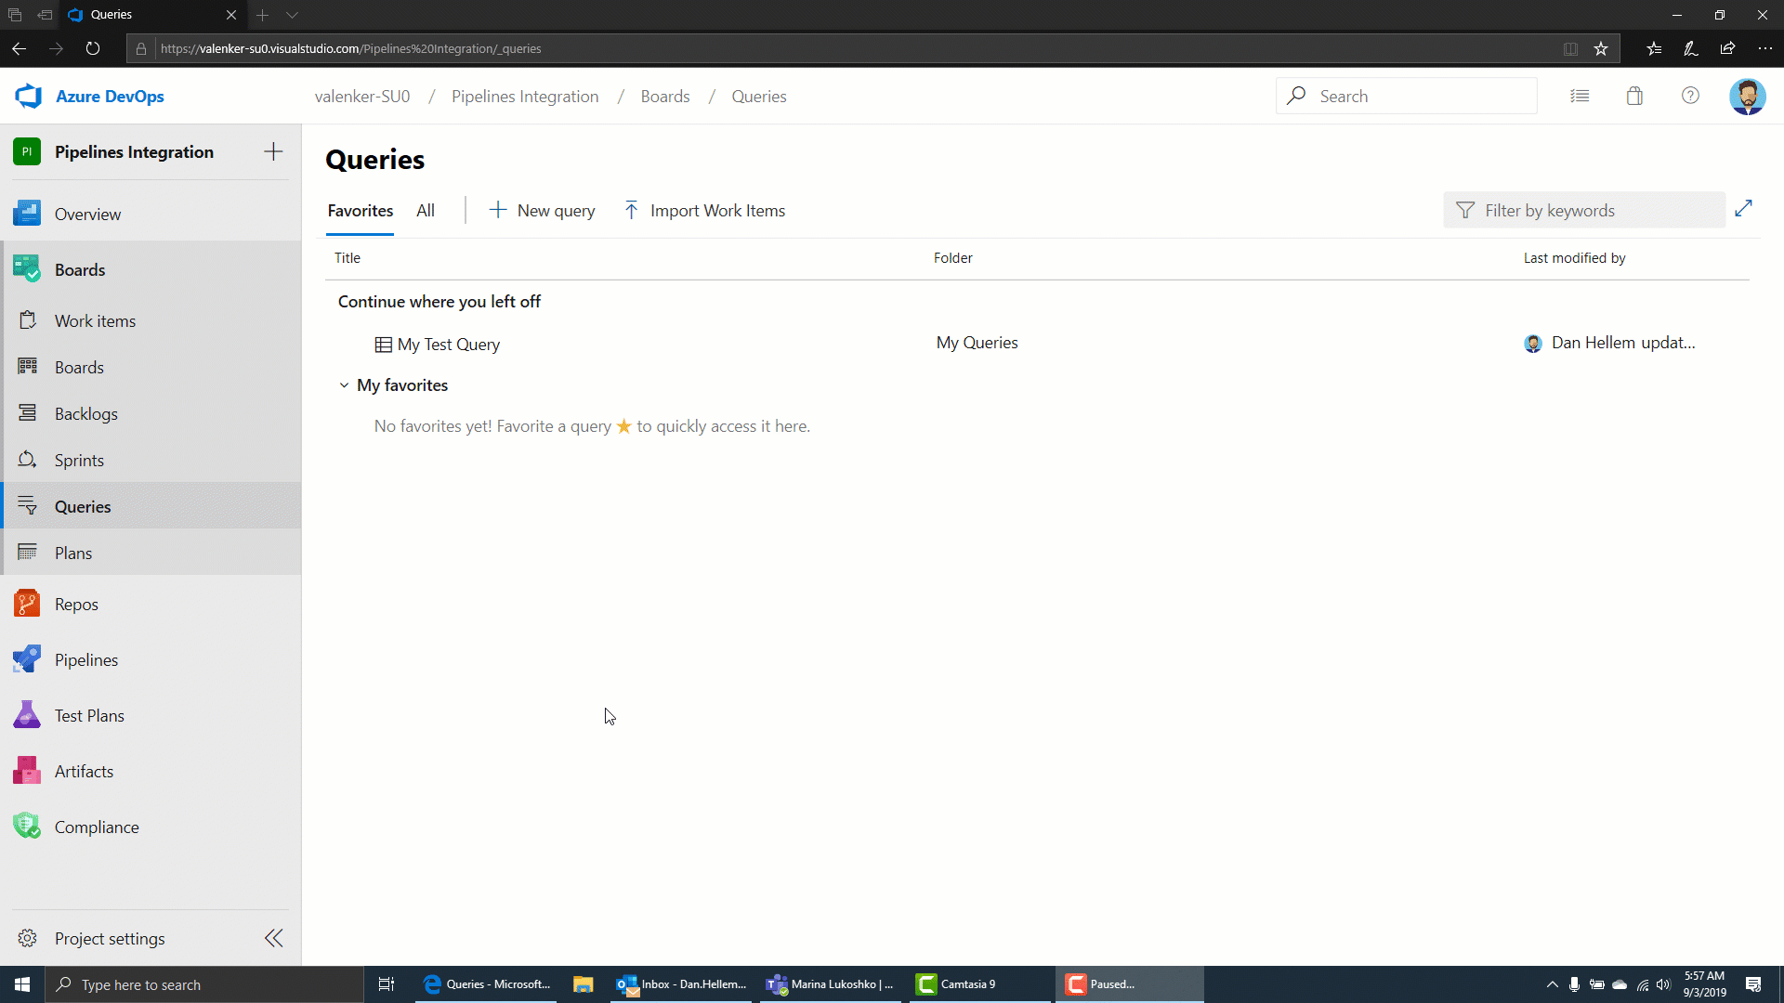

Slide 25
Azure Repos app for Microsoft Teams
Mark files as reviewed in a pull request
Proximity support for code search

Slide 26
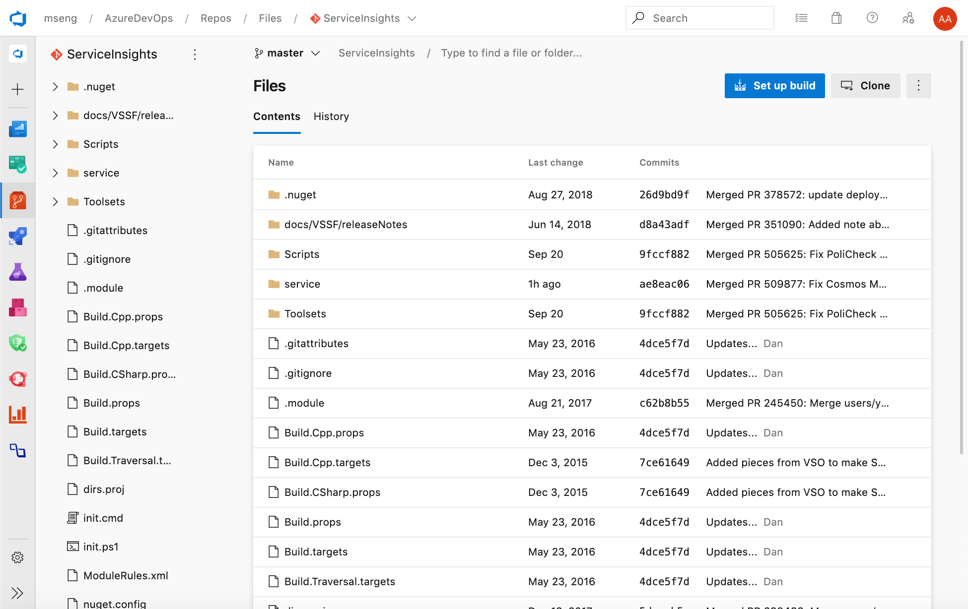

Slide 27
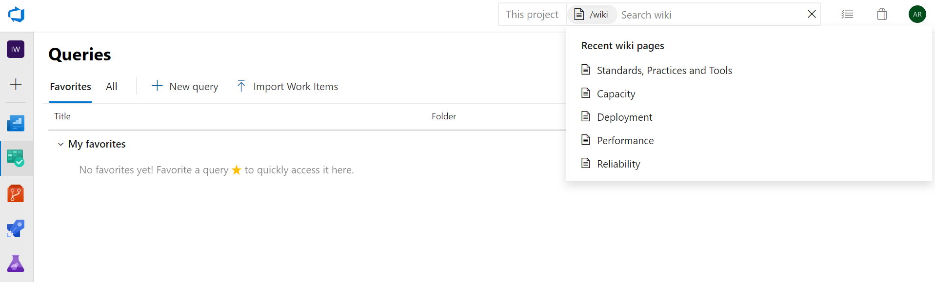
Access recently visited wiki pages

Slide 28
TeamsAppCamp

Slide 29
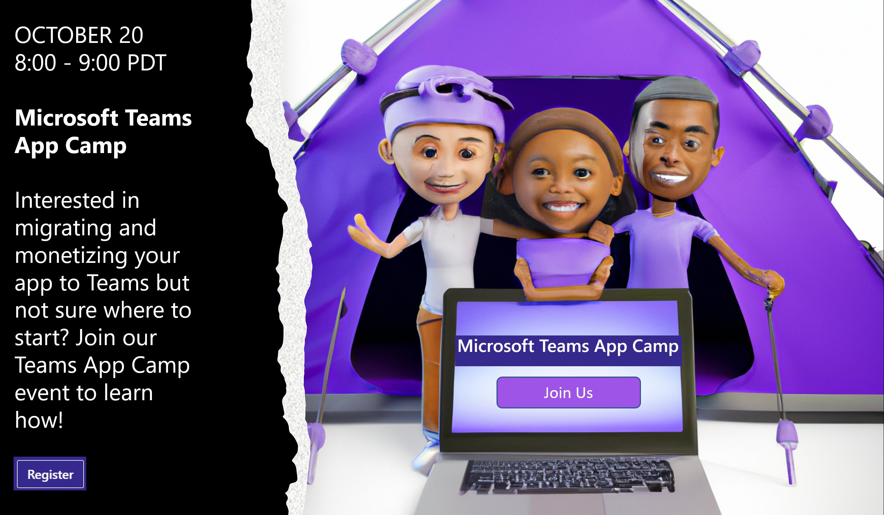

Slide 30
A computer with permission to install software (Windows, Mac, or Linux)
NodeJS
A code editor such as Visual Studio Code
ngrok to simplify local debugging and allow debugging of bots and message extensions
A Microsoft 365 tenant (available free!)

Slide 31

Learn how to build Teams applications.
Extend existing application into Microsoft Teams.
Monetizing your app to Teams.
Migrating your apps to Teams.

Slide 32
https://microsoft.github.io/app-camp/

Slide 33

https://forms.gle/psHZzRRXV6WqUFks5

Slide 34
https://azure.microsoft.com/en-us/products/devops/
https://learn.microsoft.com/en-us/training/teams/
https://learn.microsoft.com/en-us/training/modules/explore-azure-pipelines/
https://learn.microsoft.com/en-us/microsoftteams/get-started-with-teams-quick-start

Slide 35



Thank you !
https://twitter.com/whatsupcoders

